Slide 1
Heaps

Slide 2
Heaps
A heap is a certain kind of complete binary tree.
Notes:
A heap is a data structure with several applications, including a way to implement Priority Queues, as shown in Chapter 11. The definition of a heap is a special kind of complete binary tree.
You probably recall that a complete binary tree requires that its nodes are added in a particular order...

Slide 3
Heaps
Root
A heap is a certain kind of complete binary tree.
When a complete
binary tree is built,
its first node must be
the root.
Notes:
The first node of a complete binary tree is always the root...

Slide 4
Heaps
Complete binary tree.
Left child
of the
root
The second node is
always the left child
of the root.
Notes:
...the second node is always the left child of the root...

Slide 5
Heaps
Complete binary tree.
Right child
of the
root
The third node is
always the right child
of the root.
Notes:
...then the right child of the root...

Slide 6
Heaps
Complete binary tree.
The next nodes
always fill the next
level from left-to-right.
Notes:
...and so on. The nodes always fill each level from left-to-right...

Slide 7
Heaps
Complete binary tree.
The next nodes
always fill the next
level from left-to-right.
Notes:
...from left-to-right...

Slide 8
Heaps
Complete binary tree.
The next nodes
always fill the next
level from left-to-right.
Notes:
...from left-to-right...

Slide 9
Heaps
Complete binary tree.
The next nodes
always fill the next
level from left-to-right.
Notes:
...from left-to-right...

Slide 10
Heaps
Complete binary tree.
Notes:
...and when a level is filled you start the next level at the left.

Slide 11
Heaps
45
A heap is a certain kind of complete binary tree.
35
23
27
21
22
4
19
Each node in a heap
contains a key that
can be compared to
other nodes' keys.
Notes:
So, a heap is a complete binary tree. Each node in a heap contains a key, and these keys must be organized in a particular manner. Notice that this is not a binary search tree, but the keys do follow some semblance of order.
Can you see what rule is being enforced here?

Slide 12
Heaps
45
A heap is a certain kind of complete binary tree.
35
23
27
21
22
4
19
The "heap property"
requires that each
node's key is >= the
keys of its children
Notes:
The heap property requires that each node's key is >= to the keys of its children.
This is a handy property because the biggest node is always at the top. Because of this, a heap can easily implement a priority queue (where we need quick access to the highest priority item).

Slide 13
Adding a Node to a Heap
45
Put the new node in the next available spot.
Push the new node upward, swapping with its parent until the new node reaches an acceptable location.
35
23
27
21
22
4
19
42
Notes:
We can add new elements to a heap whenever we like. Because the heap is a complete binary search tree, we must add the new element at the next available location, filling in the levels from left-to-right.
In this example, I have just added the new element with a key of 42.
Of course, we now have a problem: The heap property is no longer valid. The 42 is bigger than its parent 27.
To fix the problem, we will push the new node upwards until it reaches an acceptable location.

Slide 14
Adding a Node to a Heap
45
Put the new node in the next available spot.
Push the new node upward, swapping with its parent until the new node reaches an acceptable location.
35
23
42
21
22
4
19
27
Notes:
Here we have pushed the 42 upward one level, swapping it with its smaller parent 27.
We can't stop here though, because the parent 35 is still smaller than the new node 42.

Slide 15
Adding a Node to a Heap
45
Put the new node in the next available spot.
Push the new node upward, swapping with its parent until the new node reaches an acceptable location.
42
23
35
21
22
4
19
27
Notes:
Can we stop now? Yes, because the 42 is less than or equal to its parent.

Slide 16
Adding a Node to a Heap
45
The parent has a key that is >= new node, or
The node reaches the root.
The process of pushing the new node upward is called reheapification upward.
42
23
35
21
22
4
19
27
Notes:
In general, there are two conditions that can stop the pushing upward:
1. We reach a spot where the parent is >= the new node, or
2. We reach the root.
This process is called reheapification upward (I didn't just make up that name, really).

Slide 17
Removing the Top of a Heap
45
Move the last node onto the root.
42
23
35
21
22
4
19
27
Notes:
We can also remove the top node from a heap. The first step of the removal is to move the last node of the tree onto the root. In this example we move the 27 onto the root.

Slide 18
Removing the Top of a Heap
27
Move the last node onto the root.
42
23
35
21
22
4
19
Notes:
Now the 27 is on top of the heap, and the original root (45) is no longer around. But the heap property is once again violated.

Slide 19
Removing the Top of a Heap
27
Move the last node onto the root.
Push the out-of-place node downward, swapping with its larger child until the new node reaches an acceptable location.
42
23
35
21
22
4
19
Notes:
We'll fix the problem by pushing the out-of-place node downward. Perhaps you can guess what the downward pushing is called....reheapification downward.

Slide 20
Removing the Top of a Heap
42
Move the last node onto the root.
Push the out-of-place node downward, swapping with its larger child until the new node reaches an acceptable location.
27
23
35
21
22
4
19
Notes:
When we push a node downward it is important to swap it with its largest child. (Otherwise we are creating extra problems by placing the smaller child on top of the larger child.) This is what the tree looks like after one swap.
Should I continue with the reheapification downward?

Slide 21
Removing the Top of a Heap
42
Move the last node onto the root.
Push the out-of-place node downward, swapping with its larger child until the new node reaches an acceptable location.
35
23
27
21
22
4
19
Notes:
Yes, I swap again, and now the 27 is in an acceptable location.

Slide 22
Removing the Top of a Heap
42
The children all have keys <= the out-of-place node, or
The node reaches the leaf.
The process of pushing the new node downward is called reheapification downward.
35
23
27
21
22
4
19
Notes:
Reheapification downward can stop under two circumstances:
1. The children all have keys that are <= the out-of-place node.
2. The out-of-place node reaches a leaf.

Slide 23
Implementing a Heap
42
We will store the data from the nodes in a partially-filled array.
35
23
27
21
An array of data
Notes:
This slide shows the typical way that a heap is implemented. For the most part, there is nothing new here, because you already know how to implement a complete binary tree using a partially-filled array. That is what we are doing with the heap.

Slide 24
Implementing a Heap
42
Data from the root goes in the first location of the array.
35
23
27
21
42
An array of data
Notes:
Following the usual technique for implementing a complete binary tree, the data from the root is stored in the first entry of the array.

Slide 25
Implementing a Heap
42
Data from the next row goes in the next two array locations.
35
23
27
21
42
35
23
An array of data
Notes:
The next two nodes go in the next two locations of the array.

Slide 26
Implementing a Heap
42
Data from the next row goes in the next two array locations.
35
23
27
21
42
35
23
27
21
An array of data
Notes:
and so on.

Slide 27
Implementing a Heap
42
Data from the next row goes in the next two array locations.
35
23
27
21
42
35
23
27
21
An array of data
We don't care what's in
this part of the array.
Notes:
As with any partially-filled array, we are only concerned with the front part of the array. If the tree has five nodes, then we are only concerned with the entries in the first five components of the array.

Slide 28
Important Points about the Implementation
42
The links between the tree's nodes are not actually stored as pointers, or in any other way.
The only way we "know" that "the array is a tree" is from the way we manipulate the data.
35
23
27
21
42
35
23
27
21
An array of data
Notes:
With this implementation of a heap, there are no pointers. The only way that we know that the array is a heap is the manner in which we manipulate it.

Slide 29
Important Points about the Implementation
42
If you know the index of a node, then it is easy to figure out the indexes of that node's parent and children.
35
23
27
21
42
35
23
27
21
[1] [2] [3] [4] [5]
Notes:
The manipulations are the same manipulations that you've used for a complete binary tree, making it easy to compute the index where various nodes are stored.

Slide 30
Summary
A heap is a complete binary tree, where the entry at each node is greater than or equal to the entries in its children.
To add an entry to a heap, place the new entry at the next available spot, and perform a reheapification upward.
To remove the biggest entry, move the last node onto the root, and perform a reheapification downward.
Notes:
A quick summary . . .

Slide 31
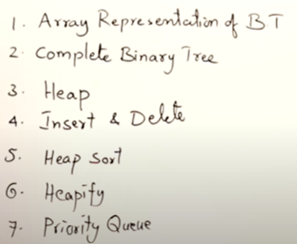
Heap Sort

Slide 32
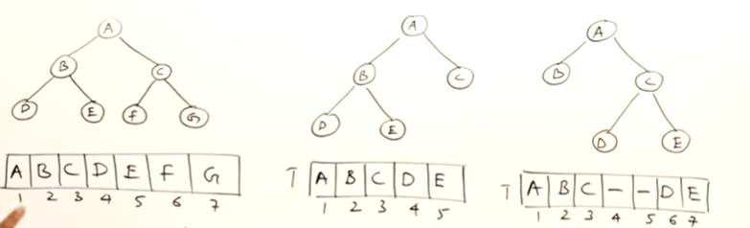
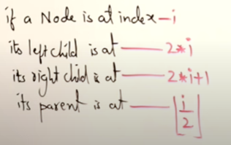
Array Representation of Binary Tree

Slide 33
Full Binary Tree Vs Complete Binary Tree
https://www.geeksforgeeks.org/difference-between-full-and-complete-binary-tree/
Height of complete binary tree is log n

Slide 34
Heap
Heap is a complete binary tree.
Parent will be greater than their child.
In max heap, maximum element is at the root
In min heap, minimum element is at the root

Slide 35
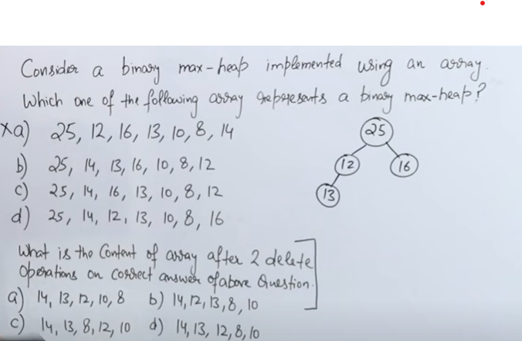
Gate 2009
Notes:
Ans C
Ans D

Slide 36
Important points about Heap Sort:
Heap sort is an in-place algorithm.
Its typical implementation is not stable but can be made stable .
Typically 2-3 times slower than well-implemented QuickSort. The reason for slowness is a lack of locality of reference.

Slide 37
Locality of Reference.
The slowness of heap sort, in terms of its runtime performance, is indeed attributed to a lack of locality of reference. To understand this, we need to delve into the concept of locality of reference and how it impacts the efficiency of sorting algorithms.
Locality of reference refers to the tendency of a computer program to access memory locations that are close to each other in a sequential or clustered manner. There are two primary types of locality of reference:
Temporal Locality: This occurs when a program frequently accesses the same memory locations over a short period of time. In other words, if you access a memory location once, you're likely to access it again in the near future.
Spatial Locality: This happens when a program accesses memory locations that are physically close to each other in a short time frame. In other words, if you access one memory location, you're likely to access nearby locations soon after.

Slide 38
Now, let's relate this concept to heap sort:
Heap sort relies on a binary heap data structure to maintain the elements being sorted. A binary heap is typically implemented as an array, where each element in the array represents a node in a binary tree. When elements are inserted, removed, or manipulated in a heap, they often jump around in memory, as the heap structure enforces specific relationships (e.g., parent-child relationships).
The lack of locality of reference in heap sort becomes evident when you consider the following:
Memory Access Patterns: Heap sort frequently accesses memory locations that are not contiguous. Elements in the heap are rearranged as the algorithm progresses, which can result in memory jumps between different parts of the array. This leads to inefficient memory access patterns.
Cache Performance: Modern computer architectures, including CPUs, have various levels of cache memory to speed up memory access. Cache performance is significantly improved when there is good spatial locality, meaning nearby memory locations are accessed in quick succession. Heap sort's scattered memory access patterns can lead to cache misses, which are expensive in terms of time.
Inefficient Memory Access: Retrieving data from different parts of memory is slower compared to accessing data stored close together. Heap sort's memory access patterns make it less efficient in utilizing memory subsystems, leading to slower execution.
In contrast, other sorting algorithms like quicksort and mergesort often exhibit better locality of reference. They operate on contiguous portions of the input data or have better memory access patterns, which can result in faster sorting times due to improved cache usage and more efficient memory access.
In summary, the slowness of heap sort is primarily due to its inefficient memory access patterns and the lack of locality of reference, which can lead to less favorable cache performance and overall slower execution compared to some other sorting algorithms.

Slide 39
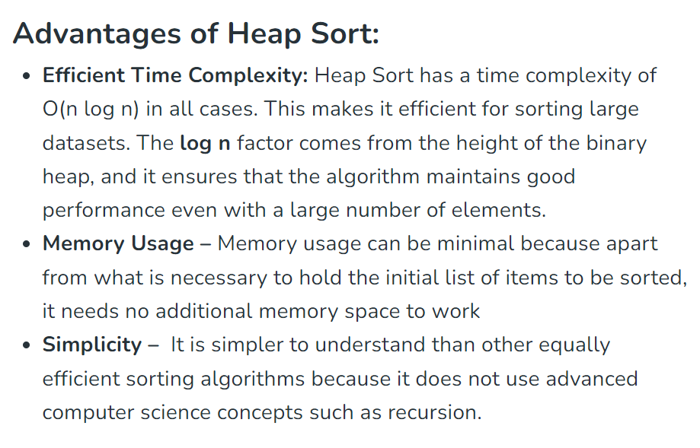

Slide 40
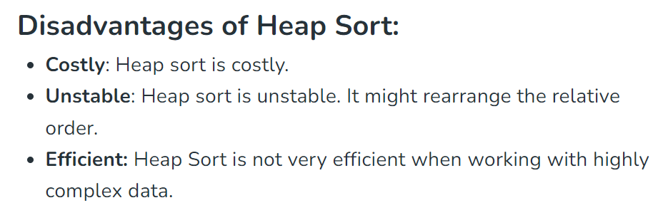

Slide 41
Heap Sort
Heap sort is a comparison based sorting technique based on Binary Heap data structure. It is similar to selection sort where we first find the maximum element and place the maximum element at the end.
We repeat the same process for remaining element.

Slide 42
Heap Sort
https://www.geeksforgeeks.org/heap-sort/

Slide 43
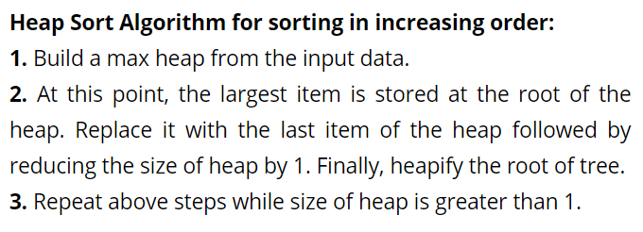

Slide 45
Worst, Average and Best Case Time Complexity: O(n log n). Worst case occurs when array is reverse sorted.
Auxiliary space: O(1)
Stable: No
Sorting In place: Yes

